Slide 1

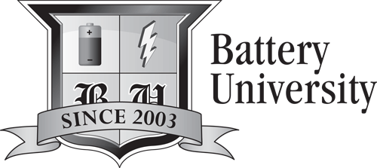
Basics about Batteries
--- Training Series ---
By Isidor Buchmann, CEO and Founder
Cadex Electronics Inc.
www.BatteryUniversity.com
Notes:
1
Isidor Buchmann is the founder and CEO of Cadex Electronics Inc., a company that manufactures innovative battery test and diagnostics equipment. Active in wireless communications, Isidor has studied the behavior of rechargeable batteries in practical and everyday use. To share battery knowledge, he wrote many articles, delivered numerous technical papers, published several books including the best selling “Batteries in a Portable World,” and created www.BatteryUniversity.com.

Slide 2
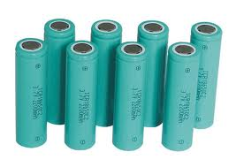
Outline
Battery chemistries
Packaging and Configurations
Charging, Discharging, Storing
How to prolong Battery Life
Summary

Slide 3


1. Battery Chemistries
The ideal battery does not yet exist

Slide 4
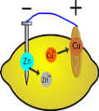
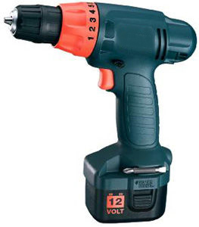
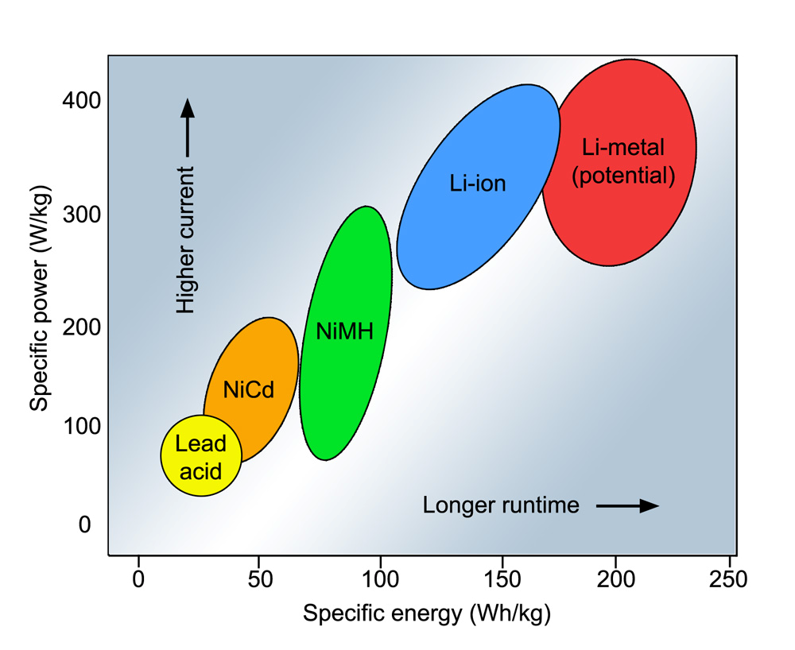
Relationship between Power and Energy
Power
Energy
Specific energy: Capacity a battery can hold (Wh/kg)
Specific power: Ability to deliver power (W/kg)

Slide 5
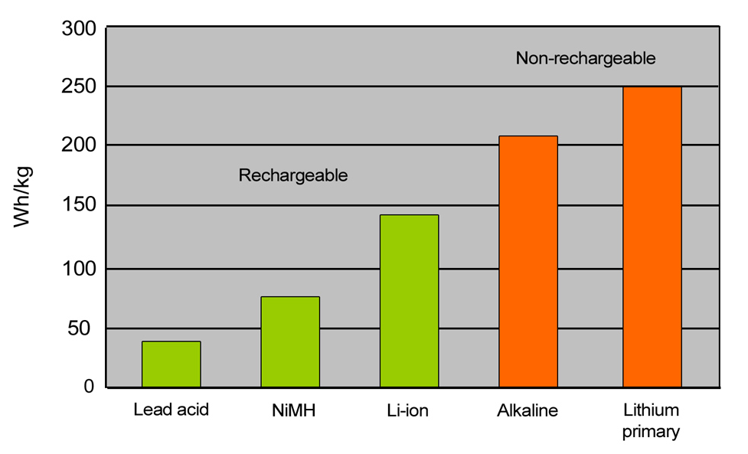
Energy storage capacity
Non-rechargeable batteries hold more energy than rechargeables but cannot deliver high load currents

Slide 6

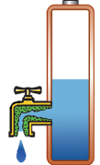

Ability to deliver current
Low power
High power
Power tool draws
up to 50 amperes
Kitchen clock runs
on a few milliamps

Slide 7
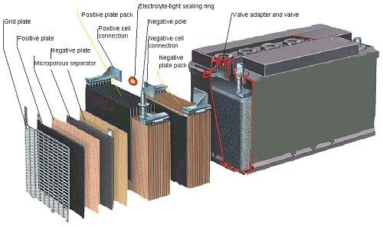
Battery chemistries
Lead Acid
One of the oldest rechargeable batteries
Rugged, forgiving if abused, safe, low price
Usable over a large temperature range
Has low specific energy
Limited cycle life, does not like full discharges
Must be stored with sufficient charge
Produces gases,
needs ventilation
Vehicles, boats, UPS, golf
cars, forklift, wheelchairs,

Slide 8

Types of Lead Acid Batteries
Flooded (liquid electrolyte, needs water)
Gel (electrolyte in gelled, maintenance free)
AGM (absorbent glass mat, maintenance free)
Lead acids come as starter, deep-cycle and stationary battery
Depth of discharge | Starter battery | Deep-cycle battery
100% | 12 – 15 cycles | 150 – 200 cycles
50% | 100 – 120 cycles | 400 – 500 cycles
30% | 130 – 150 cycles | 1,000 and more

Slide 9
Nickel-cadmium (NiCd)
Rugged, durable, good cold temperature performance
Cadmium is toxic, prompted regulatory restriction
Aircraft main battery, UPS in cold environments, vessels, vehicles needing high cycle life, power tools (not in consumer products)
Nickel-metal-hydride (NiMH)
40% higher specific energy than NiCd, mild toxicity
Not as rugged as NiCd, more difficult to charge
Consumer products, hybrid vehicles; being replaced with Li-ion
Also available in AA and AAA cells
Officials mandated a switch from NiCd to NiMH.
NiMH has same voltage, similar charging characteristics to NiCd.

Slide 10
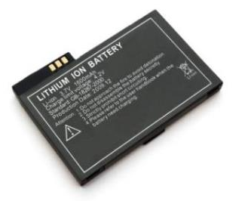
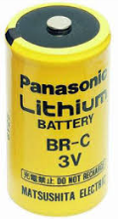
There are two types of Lithium Batteries
Lithium (metallic)
Lithium ion
(intercalated lithium
compound)
Non-rechargeable
- Heart pace makers
- Defense
- Instrumentation
- Oil drilling
Rechargeable
- Mobile phones
- Laptops
- Power tools
- Electric powertrains

Slide 11
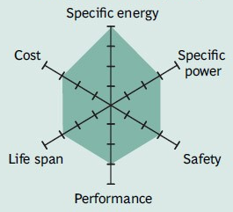
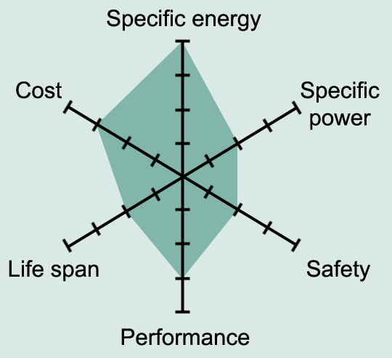
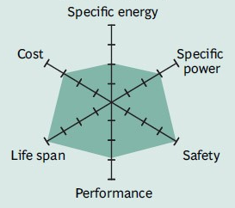
Li-ion Systems
Li-cobalt (LiCoO2)
Available since 1991, replaces NiCd and NiMH. Lighter, longer runtimes.
NMC (nickel-manganese-cobalt)
High specific energy. Power tools, medical instruments, e-bikes, EVs.
Li-phosphate (LiFePO4)
Long cycle life, enhanced safety but has lower specific energy. UPS, EVs

Slide 12

Lithium-polymer Hype
Lithium-polymer (1970s) uses a solid electrolyte. Requires 50–60°C operating temperature to attain conductivity.
Modern Li-polymer includes gelled electrolyte; can be built on Li-cobalt, NMC, Li-phosphate and Li-manganese platforms.
Li-polymer is not a unique chemistry but
a different architecture. Characteristics
are the same as other Li-ion chemistries.
Polymer serves as marketing catchword in consumer products

Slide 13
Confusion with Nominal Voltages
Lead acid: 2V/cell nominal (OCV is 2.10V/cell)
NiCd, NiMH: 1.20V/cell (official rating is 1.25V/cell)
Li-ion: 3.60V/cell (Some are 3.70V, 3.80V*)
* Cathode material affect OCV. Manganese raises voltage. Higher voltage is used for marketing reasons.
Official Li-ion Ratings
Li-ion 3.60V/cell
Li-phosphate 3.30V/cell

Slide 14
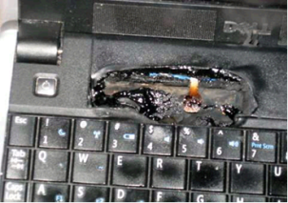
Safety concerns with Li-ion
Microscopic metal particles can puncture the separator,
leading to an electrical short circuit. (Quote by Sony, 2006)
Modern cells with ultra-thin separators are more susceptible
to impurities than the older designs with lower Ah ratings.
External protection circuits cannot stop a thermal runaway.
In case of overheating battery
Move device to non-combustible
surface.
Cool surrounding area with water
Use chemicals to douse fire,
or allow battery to burn out.
Ventilate room.

Slide 15
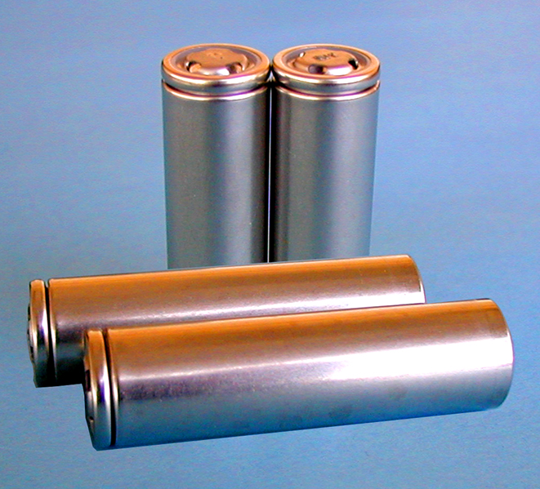
2. Packaging and Configurations
In ca. 1917, the National Institute of Standards and Technology established the alphabet nomenclature.

Slide 16
Battery formats
Type | Size (mm) | History
F | 33x90 | 1896 for lantern, later for radios, NiCd only
E | N/A | 1905 for lantern and hobby, discontinued 1980
D | 34x61 | 1898 for flashlight, later radios
C | 25.5x50 | 1900 as above for smaller form factor
B | N/A | 1900 for portable lighting, discontinued 2001
A | 17x50 | NiCd only, also in half-sizes
AA | 14.5x50 | 1907 for WWI; made standard in 1947
AAA | 10.5x44.5 | 1954 for Kodak, Polaroid to reduce size
AAAA | 8.3x42.5 | 1990 for laser pointers, flashlights, PC stylus
4.5V | 85x61x17.5 | Flat pack for flashlight, common in Europe
9V | 48.5x26.5x17.5 | 1956 for transistor radios
18650 | 18x65 | Early 1990s for Li-ion
26650 | 26x65 | Larger size for Li-ion
The inherent instability of lithium metal, especially during charging, shifted research to
a non-metallic solution using lithium ions.

Slide 17
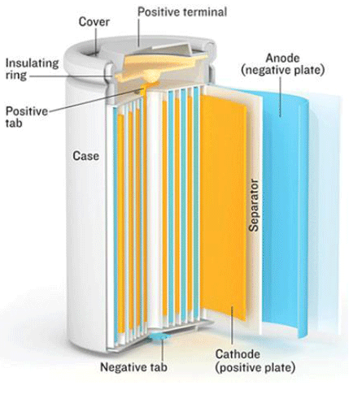
Cylindrical cell
Classic packaging for
primary & secondary cells
High mechanical stability,
economical, long life
Holds internal pressure without deforming case
Inefficient use of space
Metal housing adds to weight

Slide 18
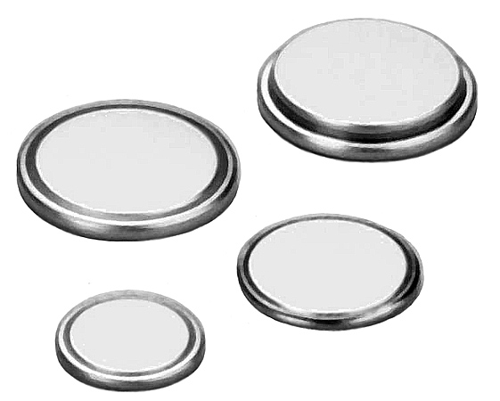
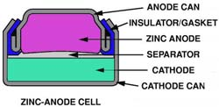
Button cell
Also known as coin cells;
small size, easy to stack
Mainly reserved as primary batteries in watches, gauges
Rechargeable button cells
do not allow fast charging
Limited new developments
Must be kept away from children, harmful if swallowed (voltage)

Slide 19
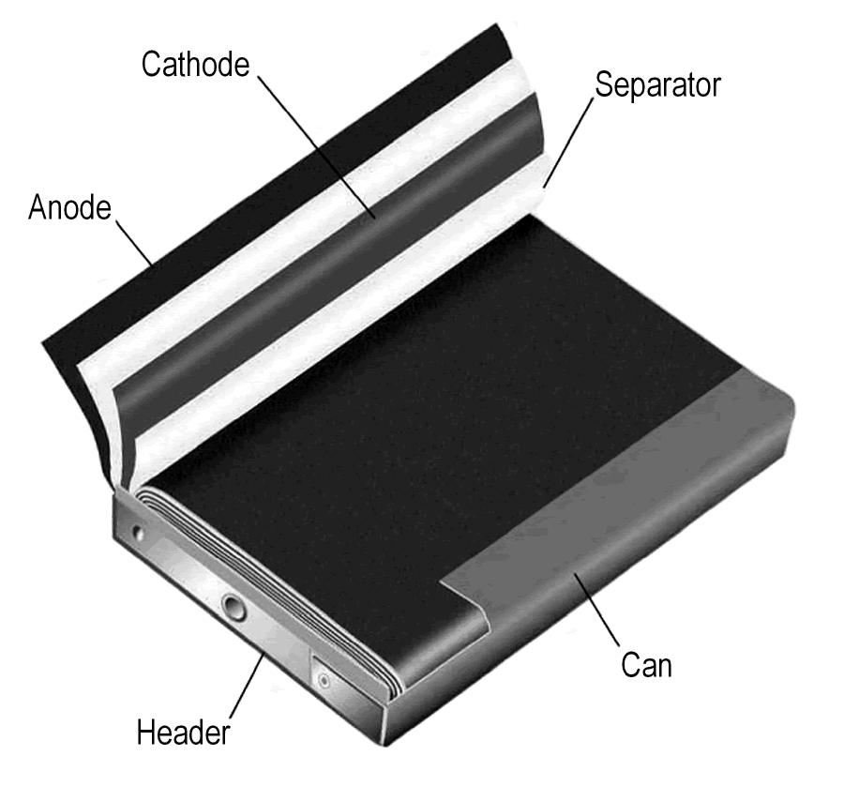
Prismatic cell
Best usage of space
Allows flexible design
Higher manufacturing cost
Less efficient thermal
management
Shorter life

Slide 20
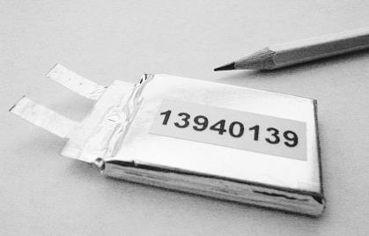
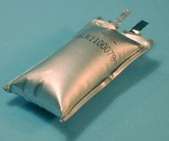
Pouch cell
Light and cost-effective to manufacture
Simple, flexible and lightweight solutions
Exposure to humidity, hot temperature shorten life
Loss of stack pressure; swelling due to gassing
Design must include allowance for 8-10% swelling
Some cells may bloat

Slide 21
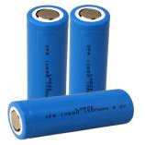
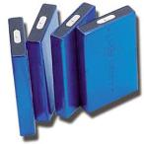
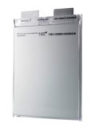
Best Cell Design
Cylindrical cell has good cycling ability, long life, economical to manufacture. No expansions during charge and discharge.
Heavy; creates air gaps on multi-cell packs. Not suitable for slim designs.
Prismatic cell allows compact design; mostly used for single-cell packs.
Less efficient in thermal management; possible shorter cycle life; can be more expensive to make.
Pouch pack is light and cost-effective to manufacture.
Exposure to humidity and heat shorten service life; 8–10% swelling over 500 cycles.

Slide 22
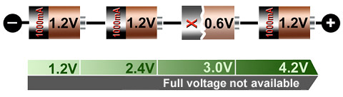
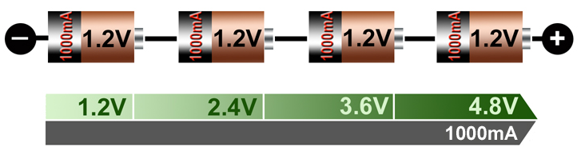
Serial connection
Good string
Adding cells in a string increases voltage; same current
Faulty string
Faulty cell lowers overall voltage, causing early cut-off
Weakest cell is stressed most; stack deteriorates quickly

Slide 23
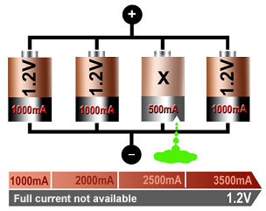
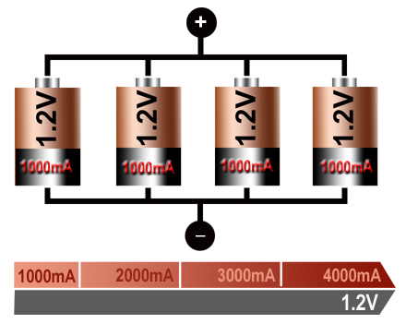
Parallel connection
Good parallel pack
Faulty parallel pack
Allows high current; same voltage
Weak cell reduces current, poses a hazard if shorted

Slide 24
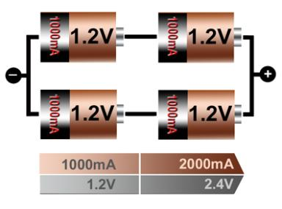
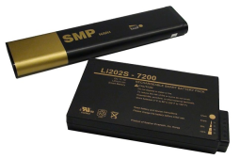
Serial-parallel connection
2S2P means:
2 cells in series
2 cells in parallel
Most battery packs have serial-parallel configurations
Cells must be matched

Slide 25
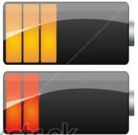
3. Charging, Discharging, Storing
A battery behaves like humans; it likes moderate temperatures and light duty.

Slide 26
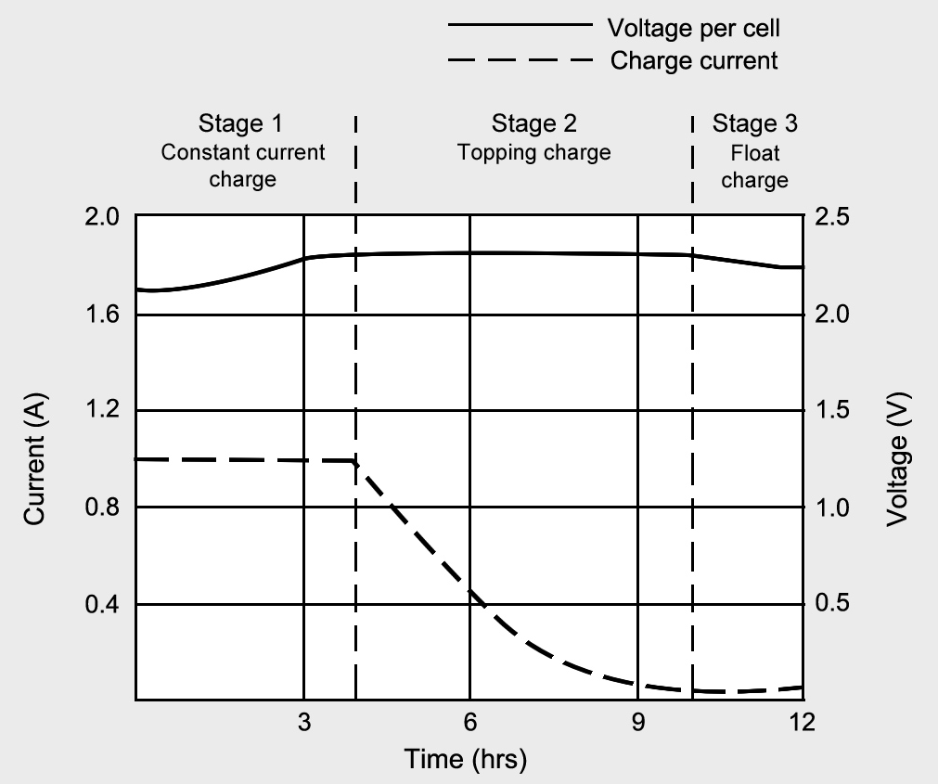
The right way to charge lead acid
Charge to 2.40V/cell, then apply topping charge
2.25V/cell float charge compensates for self-discharge
Over-charging causes corrosion, short life
Charges in ~8h. Topping charge a must
Current tapers off when reaching voltage limit
Voltage must drop when ready on float charge

Slide 27
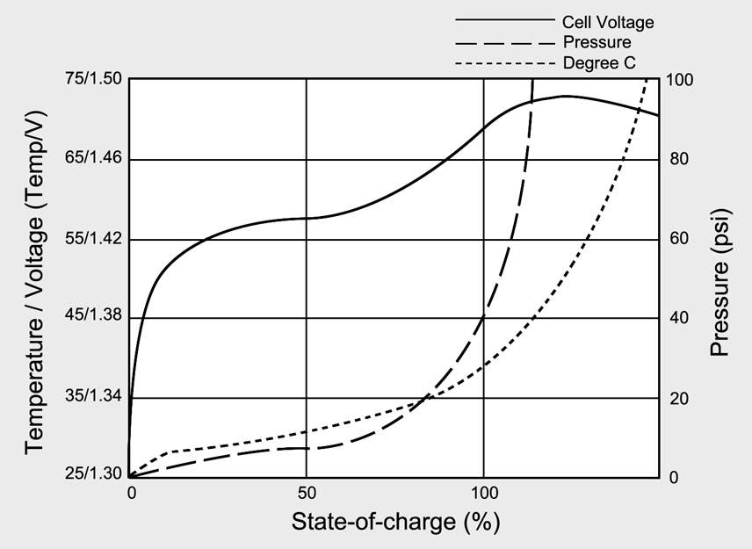
The right way to charge NiMH
Charge to 70% efficient, then battery gets warm
Full-charge detection difficult if battery faulty, mismatched
Redundant full charge detection required
Temperature sensing
is required for safety
NiCd & NiMH charge in 1-3 hours; floating voltage
Voltage signature determines full charge
Trickle charge on NiMH limited to 0.05C; NiCd less critical

Slide 28
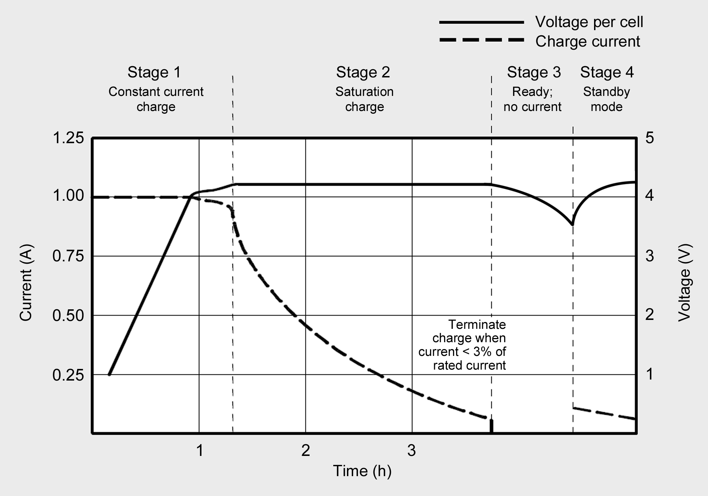
The right way to charge Li-ion
Charge to 4.20V/cell
Absolutely no trickle charge; cells must relax after charge
Occasional topping charge allowed
Li-ion charges in 1-3 hours (2/3 of time is for topping charge)
Full charge occurs when current drops to a set level
No trickle charge! (Li-ion cannot absorb overcharge)

Slide 29
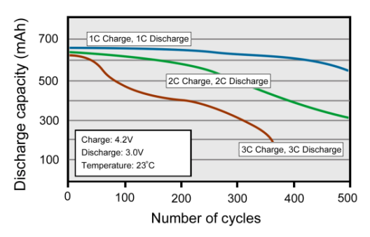
What batteries like and dislike
Lead acid needs an occasional 14h saturation charge.
Lead acid cannot be fast-charged. (A fast charge is 8h).
Charging/discharging faster than 1h (1C-rate) causes stress.
Charging and discharging Li-ion above 1C reduces service life

Slide 30
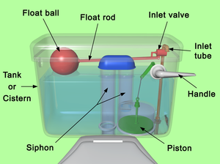
Charging / Discharging
Chargers must safely charge even a faulty battery
Chargers fill a battery, then halt the charge
Overcharge hints to a faulty charger
Discharge must be directed to a proper load
Analogy
Water-flow stops when the tank is full. A faulty mechanism can cause flooding.
Placing a brick in the tank reduces capacity.
Notes:
New batteries should be checked before deployed. Infiltrating under-performing batteries would lower system reliability.

Slide 31
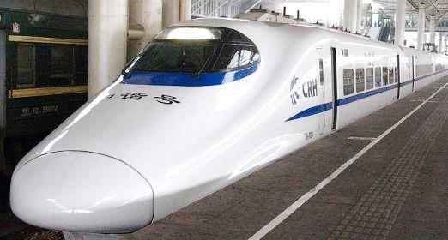
Ultra-fast charging Use moderate charge if possible
Some batteries can be charged in less than 30 minutes, but
Ultra-fast charging only works with a perfect pack
Fast-charging causes undue stress, shortens life
For best results, charge at 0.5–1C-rate (1–2h rate)
As a high-speed train can only go as fast as the tracks allow. Likewise, a battery must be in good condition to accept fast charge.
Chinese high-speed train

Slide 32
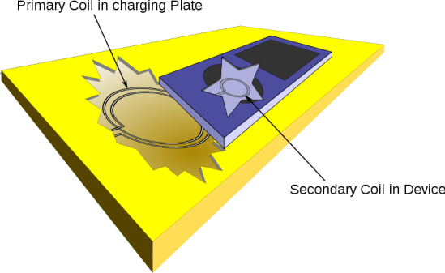
Charging without wires
Inductive charging resembles a transmitter and receiver
Received magnetic signals are rectified and regulated
Transmitter and receiver command power needs
Inductive charging is 70% efficient; produces heat

Slide 33
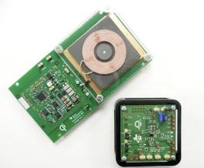
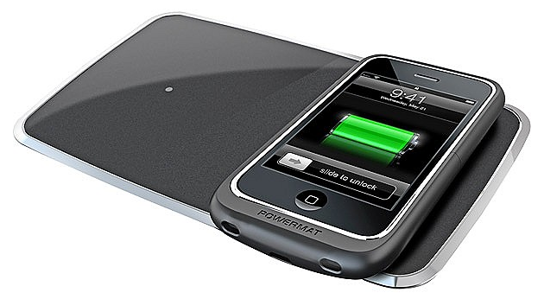
Advantages
Convenience, no contact wear
Helps in cleaning, sterilization
No exposed metals, no corrosion
No shock and spark hazard
Disadvantages
Power limit prolongs charge times
Generated heat stresses battery
Concerns regarding radiation
Complex, 25% more expensive
Incompatible standards (Qi, PMA, A4WP)

Slide 34
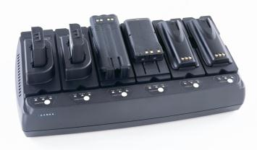
Charging at high and low temperatures
Battery Type | Charge Temperature | Discharge Temperature | Charge Advisory
Lead acid | –20°C to 50°C (–4°F to 122°F) | –20°C to 50°C (–4°F to 122°F) | Charge at 0.3C, less below freezing. Lower V-limit by 3mV/°C >30°C
NiCd, NiMH | 0°C to 45°C (32°F to 113°F) | –20°C to 65°C (–4°F to 149°F) | Charge at 0.1C between –18 and 0°C Charge at 0.3C between 0°C and 5°C
Li-ion | 0°C to 45°C (32°F to 113°F) | –20°C to 60°C (–4°F to 140°F) | No charge below freezing. Good charge/discharge performance at higher temperature but shorter life
Important: Charging has a reduced temperature range than discharging.
UCC charger by Cadex observes temperature levels while charging

Slide 35
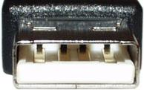
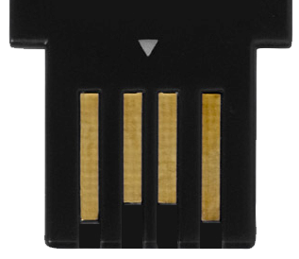
Charging from a USB Port
The Universal Serial Bus (USB) introduced in 1996 is a bi-directional data port that also provides 5V at 500mA
Charges small single-cell Li-ion
Full charge may not be possible on larger packs
Overloading may cause host (laptop) to disconnect
Type A USB plug
Pin 1 provides +5VDC
Pins 2 & 3 carry data
Pin 4 is ground.
4
1

Slide 36
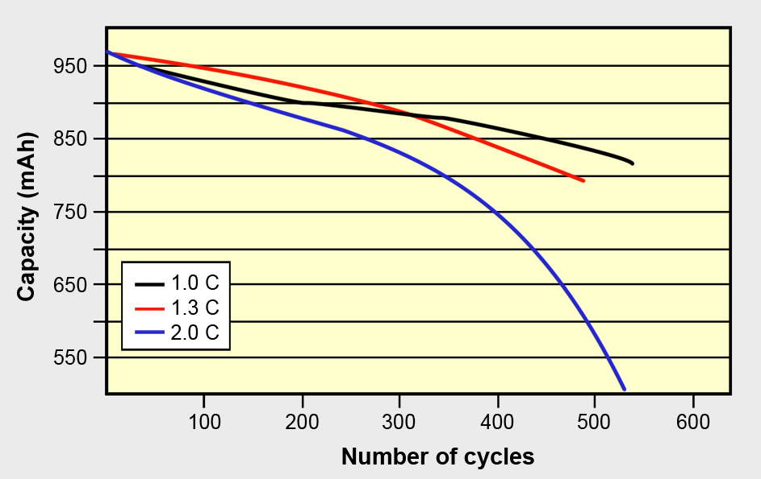
Discharge methods
Source: Choi et al (2002)
Higher loads and pulses increase stress on a battery
Weak cells in a chain suffer most on load, fast charge
Cells must be matched for high current discharge

Slide 37
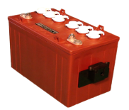
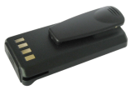
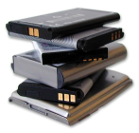
Storing
Lead acid: Fully charge before storing
- Partial charge causes sulfation
- Self-discharge increases with heat
- Topping-charge every 6 months
NiCd, NiMH: No preparation needed
- Can be stored charged or empty
- Needs exercise after long storage
Li-ion: Store at 30-60% SoC
  - Charge empty Li-ion to 3.85V/cell
- Discharge full Li-ion to 3.75V/cell
  (3.80V/cell relates to ~50% SoC)
Do not purchase batteries for long storage. Like milk, batteries spoil.

Slide 38

Health concerns with lead
Lead can enter the body by inhalation of lead dust
or touching the mouth with contaminated hands.
Children and pregnant women are most vulnerable
to lead exposure.
Lead affects a child’s growth, causes brain damage, harms kidneys, impairs hearing and induces behavioral problems.
Lead can cause memory loss, impair concentration
and harm the reproductive system.
Lead causes high blood pressure, nerve
disorders, muscle and joint pain.

Slide 39
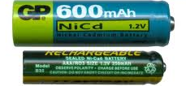
Health concerns with cadmium
Workers at a NiCd manufacturing plant in Japan
exhibited heath problems from cadmium exposure
Governments banned the disposal of nickel-cadmium batteries in landfills
Cadmium can be absorbed through the skin by touching a spilled battery; causes kidney damage.
Exercise caution when working with damaged batteries

Slide 40

Transporting Li-ion
Estimated Li-ion failure is 1 per 10 million pack
(1 in 200,000 failure triggered a 6 million recall in 2006)
Most failures occur by improper packaging
and handling at airports and in cargo hubs.
Li-ion is not the only problem battery. Primary lithium, lead, nickel and alkaline can also cause fires.
Battery failures have gone down since 2006.

Slide 41
Maximum lithium or equivalent lithium content (ELC) shipped under Section II
2g lithium in a lithium-metal battery (primary)
8g ELC in a single Li-ion pack (up to 100Wh)
25g ELC if in several packs (up to 300Wh)
To calculate ELC, multiply Ah times 0.3.
Spare batteries must be carried, not checked in.
Shipment exceeding Section II by land, sea and air must be expedited under “Class 9 miscellaneous hazardous material.”

Slide 42
FAQ on charging and discharging
FAQ | Lead acid | Nickel-based | Li-ion
Can I harm battery by incorrect use? | Yes, do not store partially charged | Do not overheat, do not overcharge | Keep cool, store ate partial charge
Is a partial charge fine? | Charge fully to prevent sulfation | Charge NiCd and NiMH fully | Partial charge fine
Do I need to use up all charge before charging? | No, deep dis-charge harms the battery | Apply scheduled discharges only to prevent “memory” | Partial discharge is better, charge more often instead
Will the battery get warm on charge? | Slight temperature raise is normal | Gets warm; must stay cool on ready | Must always remain cool
Can I charge when cold? | Slow charge only (0.1) at 0–45°C Fast charge (0.5–1C) at 5–45°C |  | Do not charge below 0°C
Can I charge at hot temperature? | Lower V threshold when above 25°C | Will not fully charge when hot | Do not charge above 50°C
How should I store my battery? | Keep voltage above 2.05V/cell | Can be stored totally discharged | Store cool and at a partial charge

Slide 43

4. How to prolong Battery Life
Batteries are sometimes replaced too soon, but mostly too late.

Slide 44
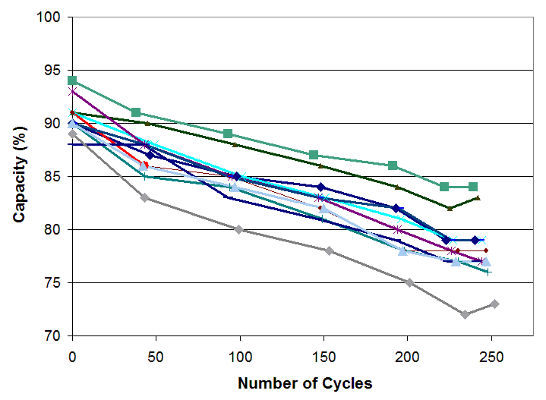
Battery fade cannot be stopped, but slowed
Li-ion provides 300-500 full discharge cycles
Capacity is the leading health indicator of a battery
A capacity-drop to 80 or 70% marks end of life
Capacity loss of 11 Li-ion batteries for mobile phones when fully cycled at 1C

Slide 45
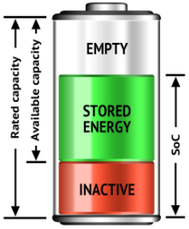
Knowing the difference between Capacity and SoC
Capacity and SoC determine the runtime but the siblings are not related
Rated Capacity (Ah) includes the Empty, Stored Energy and Inactive part
SoC includes Stored Energy and Inactive part
Available Capacity
represents the actual playfield
Notes:
New batteries should be checked before deployed. Infiltrating under-performing batteries would lower system reliability.

Slide 46
Avoid deep discharges
Cycle life as a function of depth-of-discharge (DoD)
Depth of discharge | Number of discharge cycles of Li-ion, NiMH
100% DoD | 300 - 500
50% DoD | 1,200 - 1,500
25% DoD | 2,000 - 2,400
10% DoD | 3,750 - 4,700
Satellites
Prevent deep discharges; charge more often
Only apply a deliberate full discharge for calibration
NiCd & NiMH benefit from periodic cycling (memory)

Slide 47
Keep battery cool
Function of SoC and temperature
Capacity of Li-ion after 1 year
Temperature | 40% charge | 100% charge
0°C | 98% | 94%
25°C | 96% | 80%
40°C | 85% | 65%
60°C | 75% | 60% (after 3 months)
Laptop
Heat in combination of full-charge hastens aging

Slide 48
Retain moderate charge voltage
Longevity as a function of charge voltage
Charge level V/cell of Li-ion | Number of full discharge cycles | Capacity at full charge
(4.30) | (150 – 250) | (110%)
4.20 | 300 – 500 | 100%
4.10 | 600 – 1,000 | 90%
4.00 | 1,200 – 2,000 | 70%
3.90 | 2,400 – 4,000 | 50%
Every 0.10V below 4.20V/cell doubles cycle life; lower charge voltages reduce capacity

Slide 49
Table of Battery Dos and Don’ts
Battery care | Lead acid | Nickel-based | Li-ion
Best way to charge | Apply occasional full 14h charge to prevent sulfation; charge every 6 month | Avoid leaving battery in charger on Ready for days (memory). | Partial charge fine; lower cell voltages preferred; keep cool.
Discharge | Do not cycle starter batteries; avoid full discharges; always charge after use. | Do not over-discharge at high load; cell reversal causes short. | Keep protection circuit alive by applying some charge after a full discharge.
Disposal | do not dispose; recycle instead. Lead is a toxic. | Do not dispose NiCd. NiMH can be disposed at low volume. | Environmentally friendly. Can be disposed at low volume.

Slide 50

5. Summary
The battery is energy storage device that is slow to fill, holds limited capacity and has a defined life span.

Slide 51

As long as the battery relies on an electrochemical process, limitations prevail. The ideal battery does not yet exist.
What people say . . .
Lemon battery
Lead acid is making a come-back
Li-ion replaces Nickel-based batteries
Li-ion for UPS costs 5-time more than lead acid
Capacity in Li-ion doubled since the 1991 introduction
How far batteries can go is checked in electric vehicles

Slide 52
Limitations with Current Technologies
Batteries do not die suddenly but gradually fade
with age. Capacity is the leading health indicator.
Battery diagnostics has not advanced as quickly as other technologies.
The challenge is in assessing a battery before performance degradation becomes noticeable.
Rapid-test provide 80–90% correct prediction.
Capacity measurement by a full discharge
is still the most reliable method.
Batteries must be treated like any
other part of a medical device

Slide 53

How far can the Battery go?
EV sets the upper boundary on battery feasibility.
Price and longevity dictate how far the battery can go.
Powering trains, ships and airplanes makes little sense.
Competing against oil with a 100x higher net calorific value that is tough to meet, but . . .
Petroleum cannot touch the battery that is clean, quiet, small, and provides an immediate start-up.

Slide 54



Net Calorific Values
Fuel | Energy by mass (Wh/kg)
Diesel | 12,700
Gasoline | 12,200
Body fat | 10,500
Ethanol | 7,800
Black coal (solid) | 6,600
Wood (average) | 2,300
Li-ion battery | 150
Flywheel | 120
NiMH battery | 90
Lead acid battery | 40
Compressed air | 34
Supercapacitor | 5
Complied from various sources. Values are approximate

Slide 55





Take home . . .
Cadex Products
Cadex C8000
36V, 10A/station, 400W
Cadex C7400ER
36V, 6A/station, 170W
Spectro CA-12
measures capacity
of lead acid in 15s.
UCC Chargers
Boosts, calibrates, hot/cold charging
Cadex C5100
Tests Li-ion in 30s.
Notes:
55

